Slide 1
Animated Smart Village+Aircraft

Slide 2
Agenda
Team Members
Idea Of Project
Challenges Faced and Solutions Implemented
Demo Video For Project
Software Tools that used in Project

Slide 3
Team Members
Project Name
Name | ID
1 ) Mohamed Saied | 692300407
2) Youanas Ibrahim | 692300403
3) Farouq Abdel Latif | 692300406
4)Anderw Adel | 692300420
5) Ahmed Emam Fares | 692300409
6) Martin Safy | 692300410
7) Ziad Rabia | 692300401

Slide 4
Idea Of Project
A 3D animated village scene developed using
OpenGL, featuring dynamic lighting (day/night)cycle,
animated clouds, a flying aircraft, streetlights, buildings,
trees, roads, Solar panels, and a windmill — all designed to
demonstrate
real-time graphics rendering and environmental
Simulation.

Slide 5
Challenges Faced and Solutions Implemented
Lighting Transitions (Day/Night)
Challenge: Smoothly changing ambient and directional lighting based on sun position.
Solution: Used dynamic trigonometric functions and interpolated fog/color settings.
Streetlight Lighting Effects
Challenge: Simulating realistic lighting with glow and emission at night.
Solution: Combined OpenGL light sources with glowing ground effects and emissive materials.
Camera Control & Scene Navigation
Challenge: Creating a natural camera orbit and consistent viewpoint.
Solution: Implemented orbit mechanics and look-at transformations using trigonometry.
Lighting on 3D Objects
Challenge: Achieving proper lighting and color interaction on 3D models (e.g., tree, lamp post, buildings) was difficult due to inconsistent shading and lack of material reflection.
Solution: Applied material settings using glMaterial functions to define ambient, diffuse, and specular properties. Enabled GL_COLOR_MATERIAL to synchronize material properties with object colors, resulting in more realistic lighting behavior on surfaces.

Slide 6
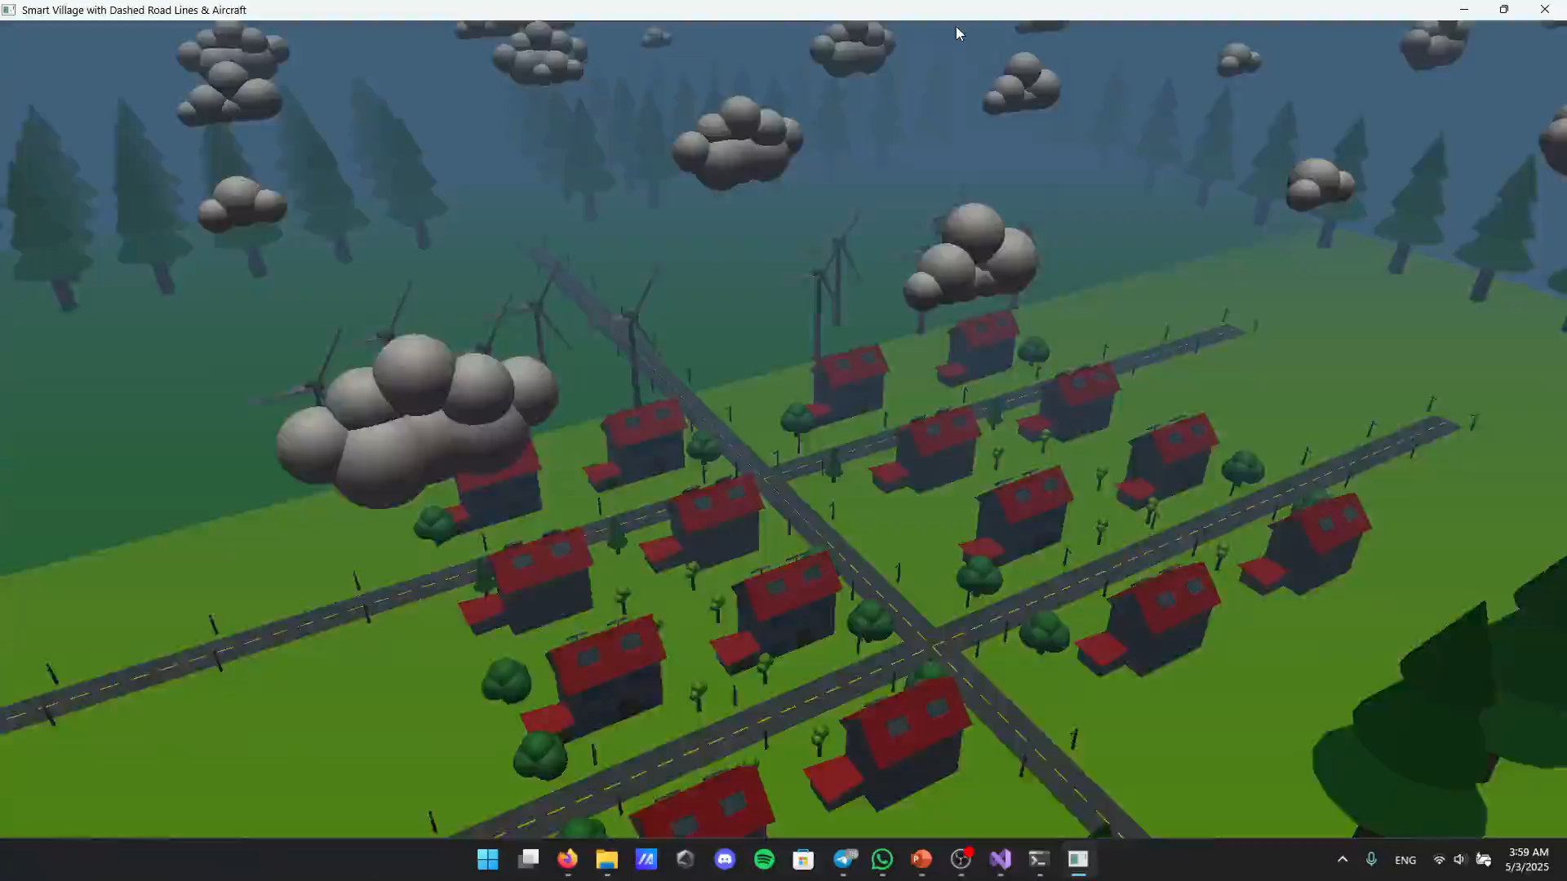
Demo Video For Project

Slide 7
Software Tools that used in Project
OpenGL Functions like glBegin, glEnd, glVertex3f, glColor3f, GL_LIGHTING , GL_BLEND , GL_SRC_ALPHA , GL_ONE_MINUS_SRC_ALPHA , GL_TRIANGLE_FAN , GL_LIGHT1 , GL_LINES , GL_LIGHTING , GL_QUADS , GL_TRIANGLES , GL_QUAD_STRI , GL_COLOR_MATERIAL , GL_FRONT, GL_AMBIENT_AND_DIFFUS , GLUT_ELAPSED_TIME and glClear indicate OpenGL’s role in scene rendering.
GLUT (OpenGL Utility Toolkit)
Functions like glutDisplayFunc, glutKeyboardFunc, glutMainLoop, GLUT_DOUBLE , GLUT_RGB , GLUT_DEPTH , GLUT_MULTISAMPLE and glutInit are from GLUT.
GLU (OpenGL Utility Library)
Drawing (e.g., spheres, cylinders).
Used GLU_SMOOTH ,
Likely used for camera setup and transformations (though specific functions like gluLookAt may not be
explicitly visible in the snippet).

Slide 8
Software Tools that used in Project
Trigonometry for Orbit Mechanics & Look-at Transformations:
Trigonometric calculations were used to implement orbit mechanics and Look-at transformations, controlling the camera's movement and view within the 3D scene.
C++ – core programming language used
Visual Studio (IDE)

Slide 9
Thank You

